Slide 1

.

Slide 2
Basic Terminologies
Random Experiment
Sample Space
Elementary Events and Compound Events
Mutually Exclusive Events
Null or Impossible Event
Complimentary Events

Slide 3

Random Experiment
A Random Experiment is a situation in which
  More than one thing can happen
  The outcome is potentially uncertain

Slide 4

Sample Space
The Sample Space of a random experiment E is the set of all possible outcomes of E.

Slide 5
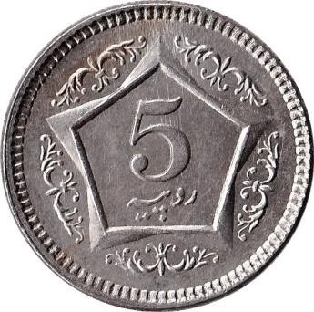
Example
E₁ = Toss a coin, observe whether it is a Head (H) or a Tail (T)
Ω₁ = {H, T}

Slide 6

Example
E₂ = Roll a die, observe the outcome.
Ω₂ = {1, 2, 3, 4, 5, 6}
E₃ = Toss a fair coin 3 times, observe the number of heads.
Ω₃ = ?

Slide 7
Example
E₄ = Toss a fair coin 5 times, observe the sequence of heads and tails.
Ω₄ ={HHHHH, HHHHT, HHHTH, HHHTT, HHTHH, HHTHT, HHTTH, HHTTT, ….
The Number of outcomes in a sample space are equal to

Slide 8
Number of outcomes in the sample space, if we toss a fair coin 5 times?
2 raise to the power 5= 2*2*2*2*2=32 sample points in the sample space.

Slide 9
.
Discuss construction of sample space of a coin tossed twice and thrice.

Slide 10
Elementary Events vs Compound Events
Any subset of the sample space is Event.
The Elementary Events in a Sample Space are the finest possible partition of the sample space. Only one outcome
Compound Events are the union of elementary events. More Than One outcome

Slide 11
Example
Roll a die. (E2)
The elementary events are
{1}
{2}
{3} ….{6}.
The events “Even” = {2,4,6}, “Odd” = {1,3,5} are examples of compound events.

Slide 12
Mutually Exclusive Events/ Disjoint Events
Two events A and B are mutually exclusive, or disjoint, if A ∩ B = φ, that is, if A and B have no elements in common.
Two or more events that cannot happen simultaneously.

Slide 13
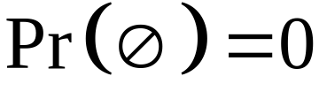
Probability of an impossible event is zero and such an event is represented by the symbol “Fie” or Null Set .
If A= { } then P(A)=0

Slide 14
Probability of an event can be expressed as 1 minus the probability of its complementary event.
For example P(M)=1-P(F) if
M represents male birth and F represent its complementary event i.e., a female birth.

Slide 15
Count the number of ways two independent events can be performed
If event A can occur in n1 ways and event B can occur in n2 ways, then the number of ways these events can occur together = n1*n2

Slide 16

Suppose that you want to dress up by choosing from 10 formal shirts (tuxedo shirts), 15 dress pants, and 7 neckties.
  You can dress up in 10*15*7=1050 ways

Slide 17
Factorial Operator
The Symbol n! is read as factorial of n and is computed as follows
n!= n(n-1)(n-2)(n-3)…..(3)(2)(1)
Example:
6!=(6)(5)(4)(3)(2)(1)=720

Slide 18

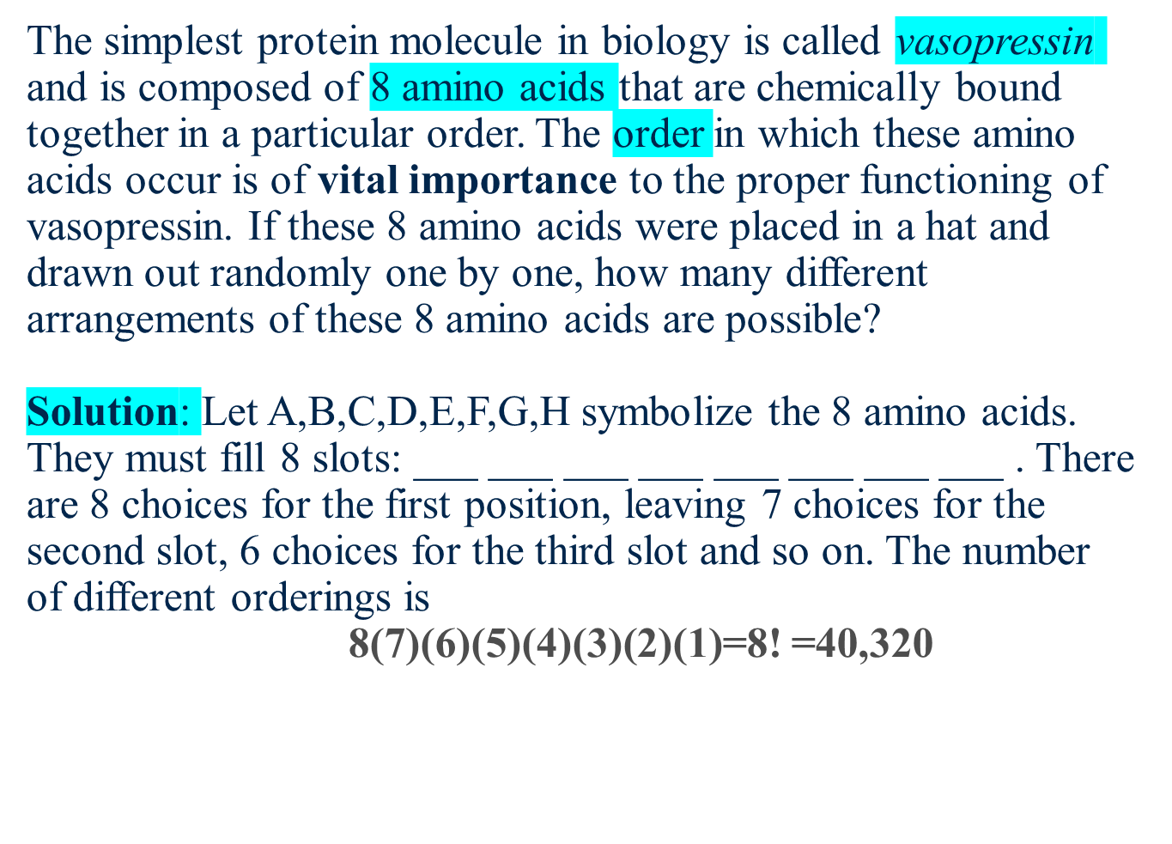

Slide 19
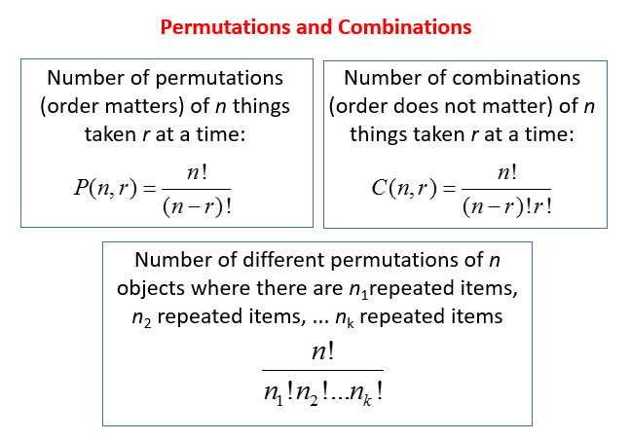
Permutations and Combinations

Slide 20

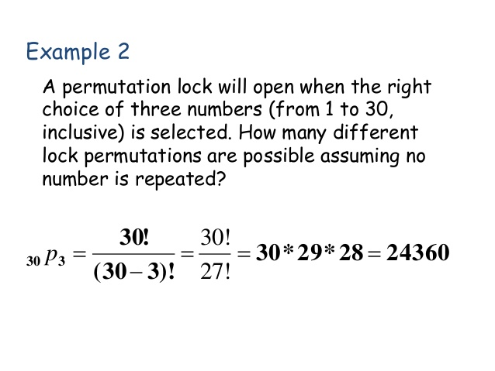

Slide 21

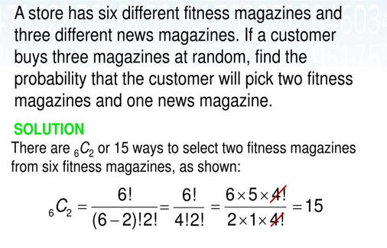
Find the probability for news magazine.

Slide 22
Probability
The chance that a given event will occur.
P(A) = n(A)/n(S)
P(A) is the probability of an event “A”
n(A) is the number of favorable outcomes
n(S) is the total number of events in the sample space.

Slide 23


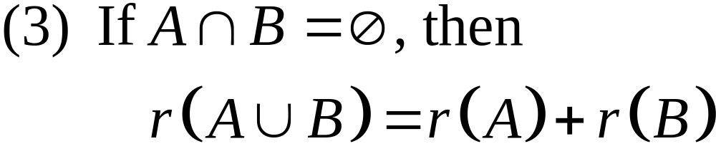
Axioms of Probability
For any events in , the following facts can be established.

Slide 24
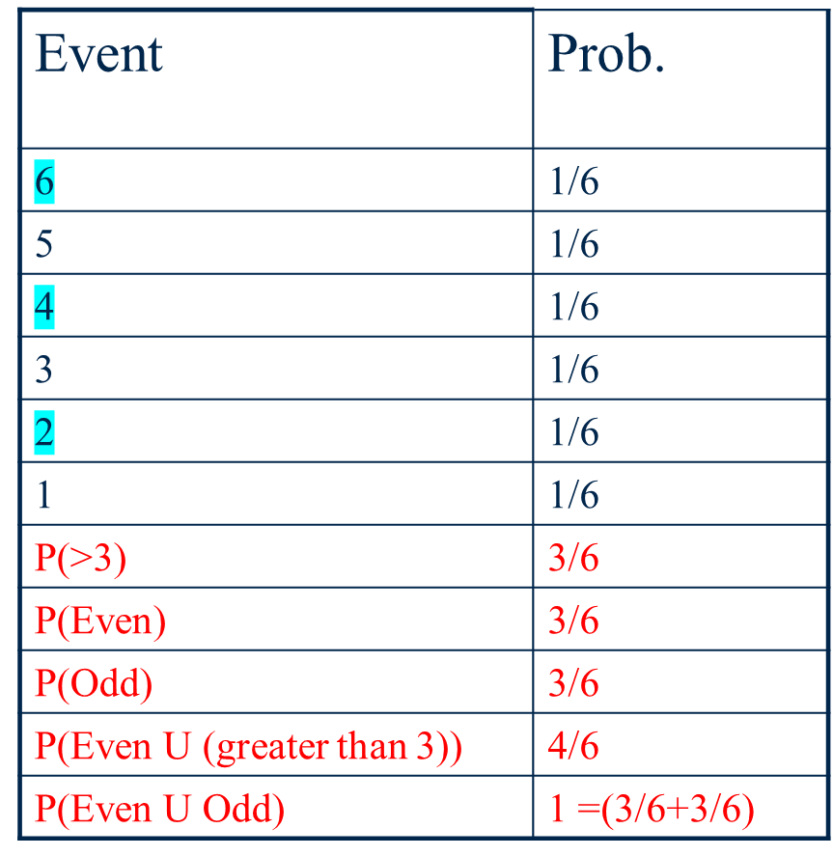
Example

Slide 25
Additive Rule
If A and B are two events, then
P(A ∪ B) = P(A) + P(B) − P(A ∩ B)

Slide 26
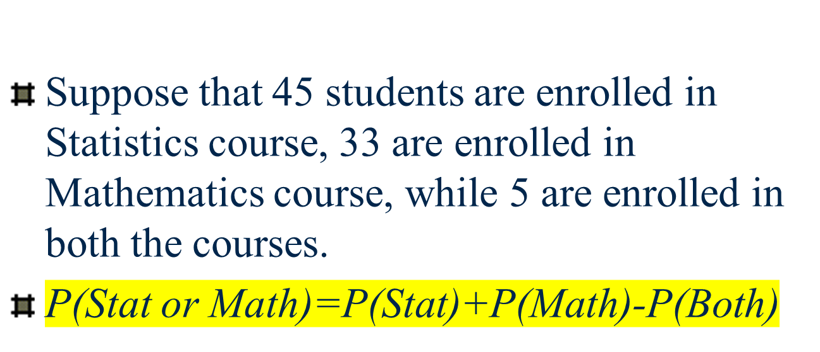
Example

Slide 27
Conditional Probability
The probability of an event B occurring when it is known that some event A has occurred is called a conditional probability and is denoted by P(B|A).
The symbol P(B|A) is usually read “the probability that B occurs given that A occurs” or simply “the probability of B, given A.

Slide 28

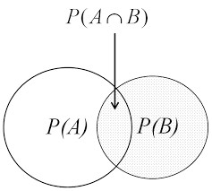
Conditional Probability
𝑃(𝐴 𝑎𝑛𝑑 𝐵)
P(A|B)=
𝑃(𝐴∩𝐵)
=
𝑃(𝐵)
𝑃(B)
𝑃(𝐴∩B)
P(B|A)=
𝑃(𝐴)

Slide 29

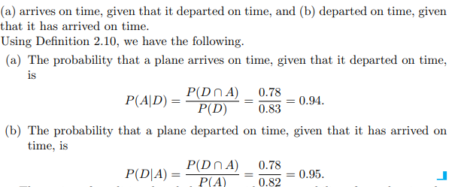
Example

Slide 30
Independent Events
Two events A and B are independent if and only if
P(B|A) = P(B) or P(A|B) = P(A),
assuming the existences of the conditional probabilities. Otherwise, A and B are dependent.

Slide 31
Multiplication Rule
If in an experiment the events A and B can both occur, then
P(A ∩ B) = P(A|B). P(B) ,
provided P(B) > 0

Slide 32


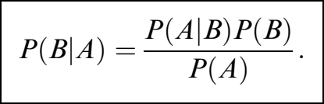
Bayes Theorem
𝑃 𝐵_{𝑖} ∩𝐴
P(𝐵_{𝑖}|A)=
𝑃(A)
𝑃 𝐴 |𝐵_{𝑖} 𝑃(𝐵_{𝑖)}
P(𝐵_{𝑖}|A)=
𝑃(A)

Slide 33
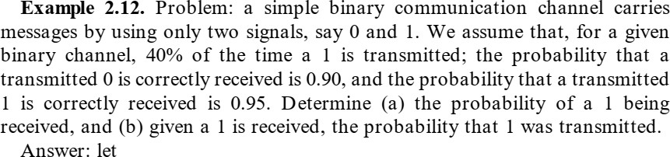
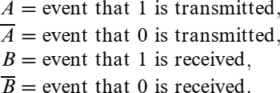
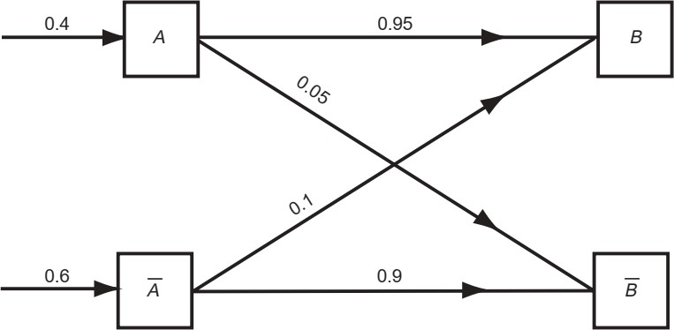
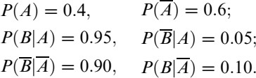

Slide 34



